Slide 1

Moving our enterprise app to the cloud: Notes from the field

Slide 2
Notes from the field
Moving our enterprise app to the cloud

Slide 3







Rik Hepworth
Chief Consulting Officer, Black Marble Microsoft MVP (Azure) Microsoft Regional Director
@rikhepworth
github.com/rikhepworth
rikhepworth.com

Slide 4
What are we going to cover?
What the application architecture looked like on-prem
What our expected migration plan looked like
What The Customer wanted (or thought they did)
What our experimental cloud architecture looks like
Where we are going next

Slide 5
Rik’s Stages of Migration
Evaluation: Make sure you understand how your application runs right now
Translation: Put what you have in the cloud, unchanged, using IaC and automation
Experimentation: Test the alternative hosting options for your service
Modification: Revise components to run in the cloud
Operation: When you’ve reached a reasonable solution for production

Slide 6

Evaluation
Make sure you understand how your application runs right now

Slide 7











Architecture
ServiceBus for Windows Server
Windows/Android Client
Client API
Windows Services
BizTalk
ADFS
Redis (Windows)
Internal APIs
External Systems
SQL DB + FILESTREAM
SSRS

Slide 8
The Technology Landscape
Planning Ahead
Constraints
IIS-hosted API, deployed with WebDeploy
Windows Services, packaged in Zip, will run as console app
SQL Databases, deployed with DacPac
Authentication via ADFS + ADAL
Service Bus for Windows Server
Redis Cache for Windows
SQL Filestream used for BLOBS
SQL DacPac target is SQL Server
Regular user data import from Active Directory via LDAP
Access to connected systems only via customer network
BizTalk (integration layer)
SSRS (for export)

Slide 9
Expected Migration
Component
Current
Initial Migration
Future Plans
APIs
Hosted in IIS
Azure Websites
Azure APIM, Websites, Functions
Windows Services
Windows Services
Azure WebJobs
Azure Functions
Redis (Windows)
Redis for Windows
Azure Redis
Azure Redis
SQL DB + FILESTREAM
SQL Server
SQL Server VM
SQL Azure
BizTalk
BizTalk
BizTalk VM
Azure Logic Apps, Functions
SSRS
SQL Reporting Services
SQL Server VM
Azure Functions
ADFS
ADFS
ADFS
Azure AD

Slide 10
Customer Position
Pro
Con
OS and software components end-of-life
Customer hardware replacement project triggered review
Adoption of Office 365 softened cloud position
Lack of cloud expertise
Security concerns and constraints
Connectivity constraints
Timescales for full cloud migration

Slide 11
Telemetry
Critical in profiling application performance
Important in providing usage data
Essential during migration to assess progress and application operation
Helped identify areas of development focus
Takes development to fully exploit

Slide 12
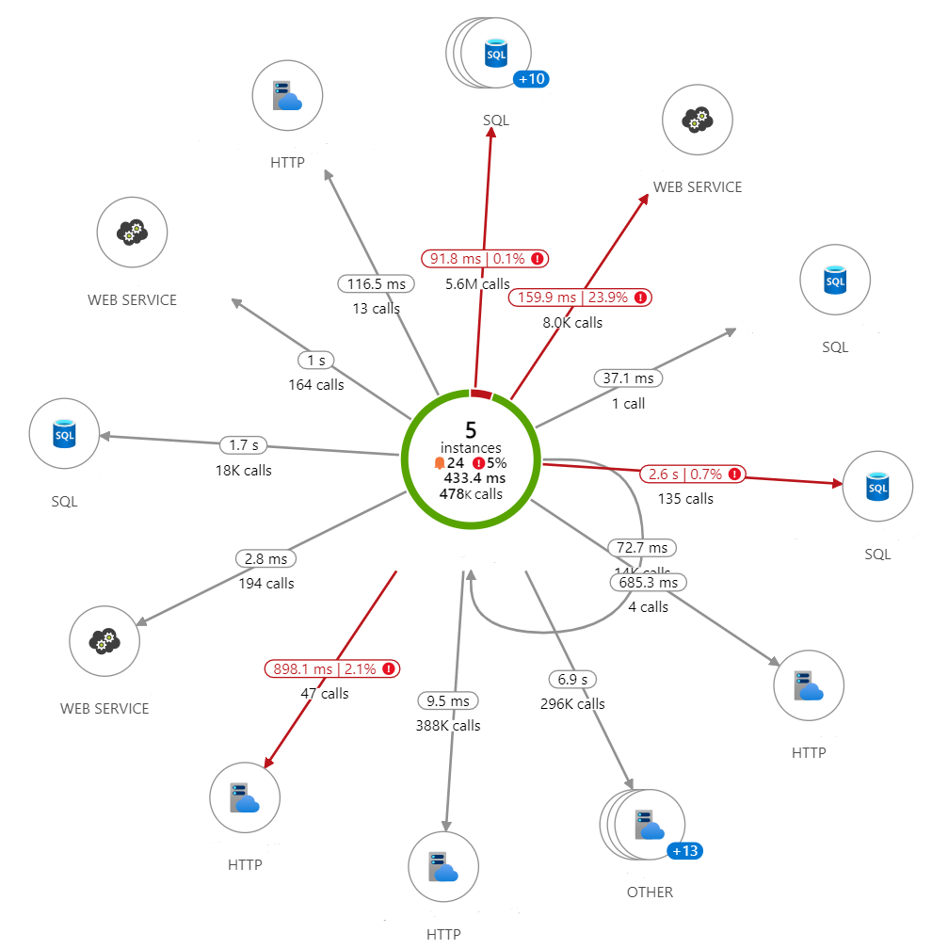
Telemetry: Stages
1
Application Insights agent deployed to host servers
Provides performance counters, requests and exceptions
Enable SQL dependencies for more information
Doesn’t include Windows Services
Treats any 400+ response as failure (challenging with REST)
2
Connect existing nLog to Application Insights
Provides easy searching of existing logs
Low log level provides little information
High log level has large storage and cost for questionable benefit
3
Add custom telemetry using SDK
Emit dependency information
Emit custom events
Provides clearer data on what’s going on

Slide 13
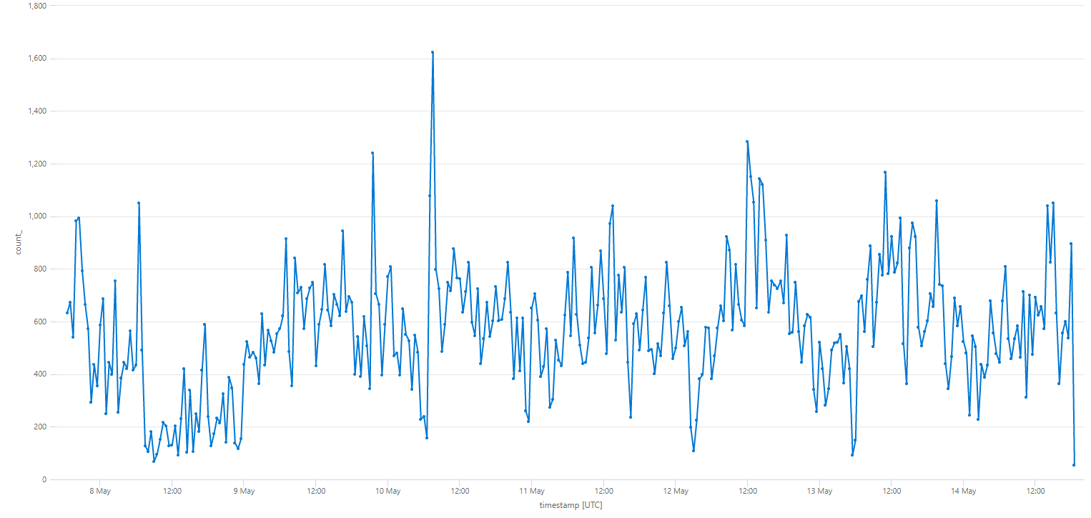
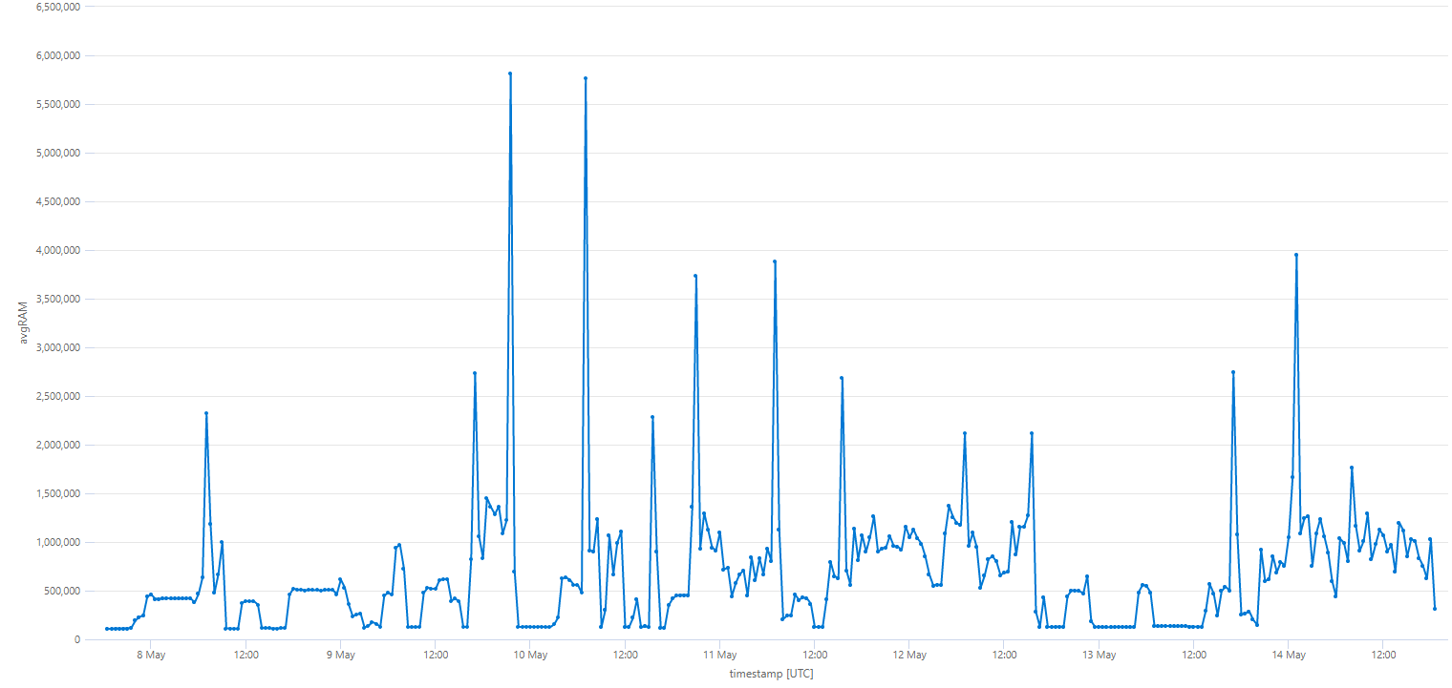
Telemetry: Estimating capacity
API requests over time
requests
| parse url with *'//' ServiceName '/'*
| summarize count()by ServiceName, bin(timestamp, 30m)
| render timechart
Server memory use over time
search in (performanceCounters) "priv*bytes"
| summarize avgRAM = (avg(value)/(1024
)) by cloud_RoleInstance, bin(timestamp, 30m)
| render timechart

Slide 14

Translation
Put what you have in the cloud, unchanged, using IaC and automation

Slide 15
Translation Challenges
Virtual Network and Virtual Machines is well understood, but…
ServiceBus for Windows and Redis must be replaced with Azure services
Safe access to services needs Front Door or Application Gateway
With customer security in mind, we need to connect everything through a vNet bubble

Slide 16
Initial Azure Architecture

Slide 17
Deployment Pains
Don’t deploy by hand. IaC for this took a day to create and another couple to debug/tweak
Bicep is so much nicer than ARM!
Debugging Front Door can be a pain when layered with PrivateLink and an Internal Load Balancer
Enabling WAF on Front Door can result in blocked traffic through false positives. Telemetry is key.
You need to understand how your on-premises VMs are configured to get the cloud version right

Slide 18

Experimentation
Test the alternative hosting options for your service

Slide 19
Automation enables experimentation
IaC allows addition of Azure Web Apps and other services
Repeatable, reliable deployment of environments is critical for testing and any move to production
Deployment pipeline enables deploy to cloud services
Automated tests are nice, but documented steps will do
Comparison with the current system behaviour is critical

Slide 20
Experimental Azure Architecture

Slide 21
Can we deploy to Azure SQL?
No
Our DacPacs target ‘SQL 2019 or SQL Managed Instance’ after some work, but ‘Azure SQL’ is now separate and different
Some pre- and post-deploy scripts fail and need review/rework
Filestream prevents one DB from deploying (even to Managed Instance)
DacPac creates Agent jobs (which don’t exist in the cloud)

Slide 22
Does the API work in App Services?
Yes, but…
Database access requires SQL login (as expected)
SQL Server Filestream requires Windows Authentication (unexpected)
(SQL 2022 allows Azure AD authentication but we’ve not tried that yet)
Binary file upload fails unless we mount Azure Files for file storage
Configuration in web.config is complex to apply via App Services Configuration settings

Slide 23
Do Services run as WebJobs?
No
But we can fix them without much effort.
This should be enough for most of our services
WebJob Output
Our Code
[INFO] Cannot start service from the command line or a debugger. A Windows Service must first be installed (using installutil.exe) and then started with the ServerExplorer, Windows Services Administrative tool or the NET START command.
if (!Environment.UserInteractive)
{
…
}
else
{
…
}
RunAsConsole();

Slide 24

Modification
Revise components to run in the cloud

Slide 25
Changing Code…
Third-party Nuget dependency updates caused the most unexpected disruption
Move to Nuget packages rather than connected projects for our own code gave huge benefit
Service Bus and Redis mandate dependency updates but remove on-prem support
Azure SignalR offers some opportunities
A change in how we upload media opens up opportunities to remove FILESTREAM
Migration to .Net 6 (some of our internal dependencies are already .Net Standard but these too need attention)

Slide 26

Operation
When you’ve reached a reasonable solution for production

Slide 27
Running the Cloud-based service
Existing skills transfer for the IaaS components
As an IT Pro, much of the cloud stuff is ‘familiar’
Automation is critical to management – infrastructure and binaries
If things aren’t working, Cloud can be a cruel mistress.
Diagnosis can be difficult with some services; rigor is needed if changes are made

Slide 28
In the end…
The customer decided on a hybrid approach.
They didn’t like cloud that much, really, and they had some shiny new tin
Several key services are now in Azure: Service Bus, Redis, Application Insights
PaaS services will be added in preference: SignalR is under investigation
Hybrid acceptance offers new possibilities: Azure Notification Hubs also under investigation
SQL FILESTREAM is a key blocker but is now linked to other changes
Budget is now planned to support move away from VMs and into cloud over time
Changes to external systems have enabled an ongoing move away from BizTalk

Slide 29
Learnings
Architecting with cloud in mind is valid (and important)
‘Cloud-ready’ architecture choices degrade over time
Some on-prem components are hard to replace quickly and can be an anchor
Sometimes things you thought would work don’t because you missed something important
Without telemetry you will fail through ignorance
Hybrid is an enabler and a valid architecture but IaaS in the long term is a budget drain
Ops team expertise is a key factor
Cloud service lifecycle can be a hindrance

Slide 30
Thank you for listening Any questions?
@rikhepworth
github.com/rikhepworth
rikhepworth.com

